Slide 1
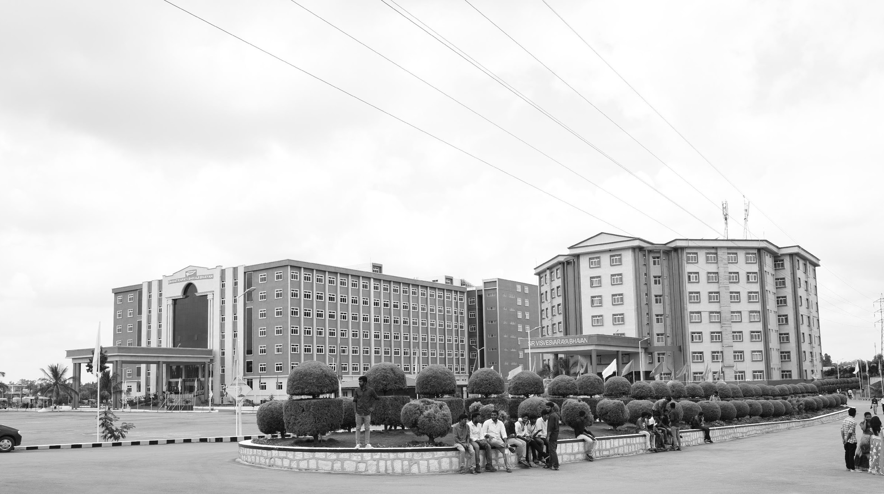

STUDY OF DIGITAL,ANALOG AND MIXED SIGNAL SYSTEMS ACROSS DIFFERENT ARCHITECTURES
Mid-Review-3
Major Project
Project ID: PROJ3999
AY 2021-25
GITAM (Deemed-to-be) University
Project Team:
BU21EECE0100376
BU21EECE0100080
BU21EECE0100294
Department of Electrical Electronics and Communication Engineering
Project Mentor:
Dr. Prithvi Sekhar Pagala
Project In-charge:
Dr. Rohan Prasad
www.gitam.edu

Slide 2
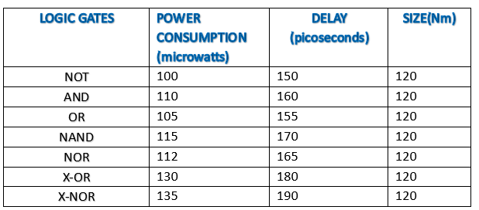
Capstone Project 1 : Summary
This project focused on the building a microprocessor using basic building blocks of a microprocessor.
It included studying components like logic gates, ALU, which are essential for building circuits.
It also looked at comparing the technologies like CMOS, MOSFET, and BJT to find ways to make circuits faster, more efficient, and reliable.
The circuits were tested and analyzed using a simulation tool called Cadence Virtuoso Tool.
Different system designs were compared based on their power consumption, size, speed, and delay. Important performance factors like power consumption, speed, size and scalability were also studied to understand how they affect system designs.
CMOS

Slide 3
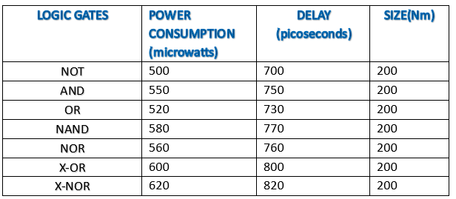
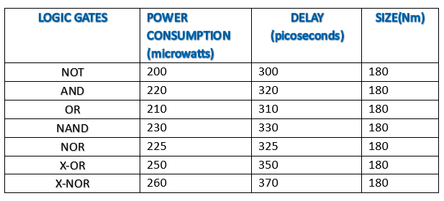
Capstone Project 1 : Summary
BJT
MOSFET

Slide 4
Objective and Goals
Objective
Study and integrate CMOS,BJT, basic MOSFET technology into the circuit design process.
Design analog, digital, and mixed-signal subsystems as building blocks for the microprocessor.
Ensure the microprocessor meets key performance metrics like low power consumption , size , delay and high speed.
Validate and optimize the designs through simulation and testing.
Compare the designed microprocessor with traditional architectures to highlight improvements.
Goals
Exploring High-Performance and Efficient Devices.
Design a custom microprocessor using knowledge from analog, digital, and mixed-signal systems.
Implement previously studied circuits using CMOS, BJT, basic MOSFET technology for improved performance
Develop a system that is efficient in terms of power, speed, size and delay.

Slide 5
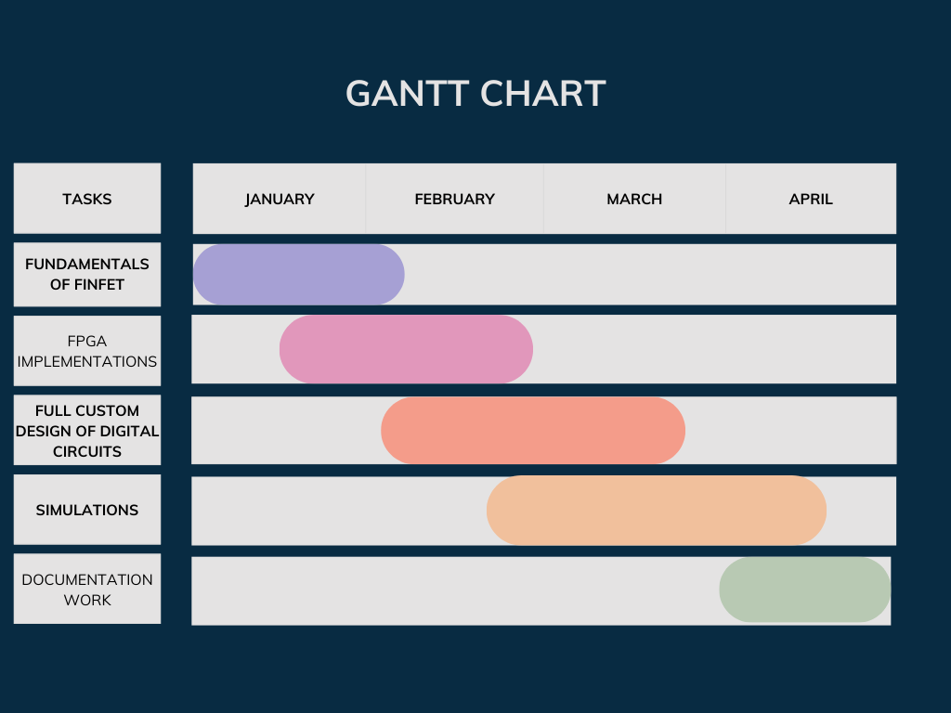
Project Plan
Gant Chart - Milestones and Activities

Slide 6
Literature Survey
Key Publications
VLSI DSP education
A Mixed-signal Analog-Digital Integrator Design
A case study of mixed-signal integrated circuit testing: an application of current testing using the upper limit and the lower limit
A comparative study of advanced mosfet concepts.
Key Resources – Whitepaper| Application Notes | Datasheet| Others
https://ieeexplore.ieee.org/document/9167646
https://ieeexplore.ieee.org/document/10592992
https://ieeexplore.ieee.org/document/6649058
Existing Implementations – Products| Opensource| GitHub etc
https://github.com/bernardlee99/4-bit-alu
https://github.com/microchip-pic-avr-examples/pic18f56q71-led-current-control-opamp
https://github.com/jbp261/Microcontroller-Projects/blob/master/ADC-DAC/README.md

Slide 7
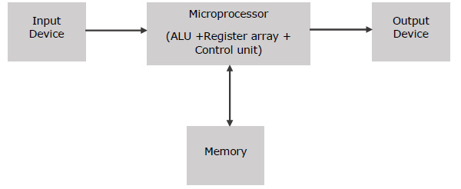
Architecture
Microprocessor
BASIC COMPONENTS :
Input device
Output device
ALU
Memory (flip-flops)

Slide 8
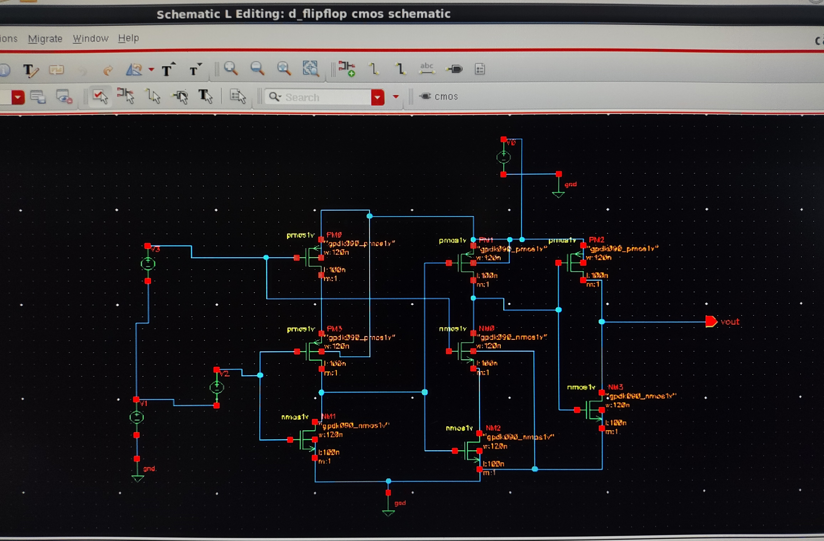
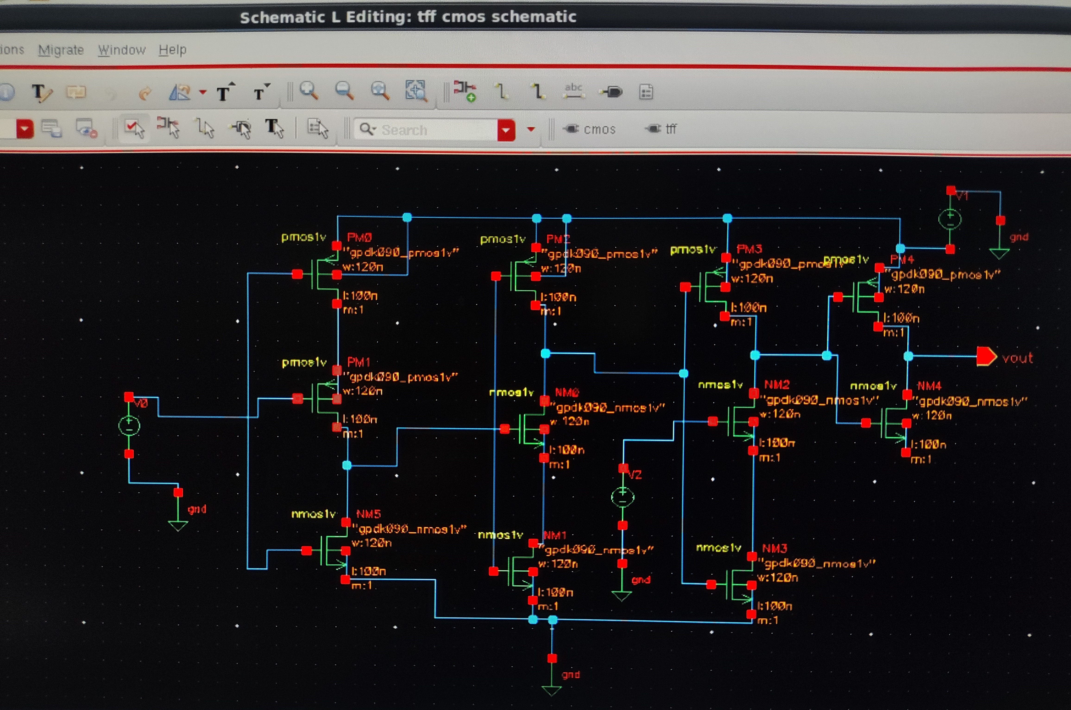
Schematic Diagrams
FLIPFLOPS(MEMORY)
D-FlipFlop
T-FlipFlop

Slide 9
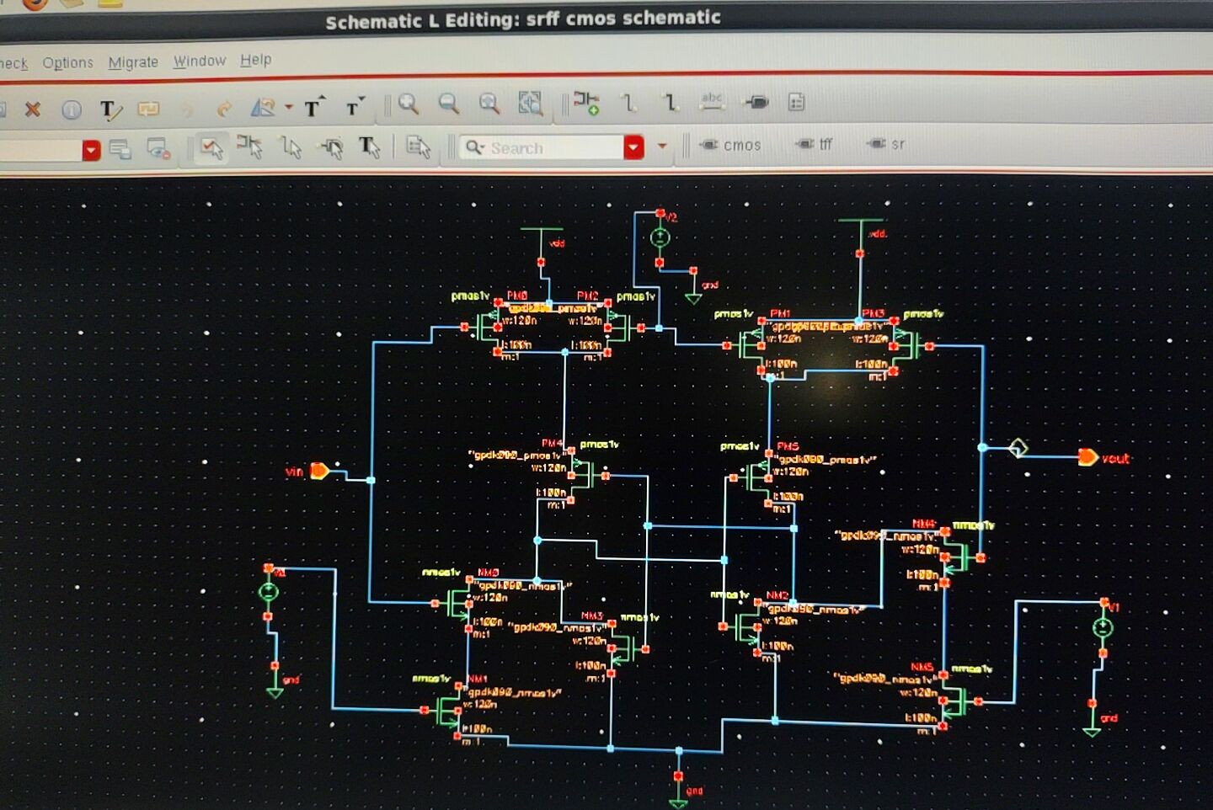
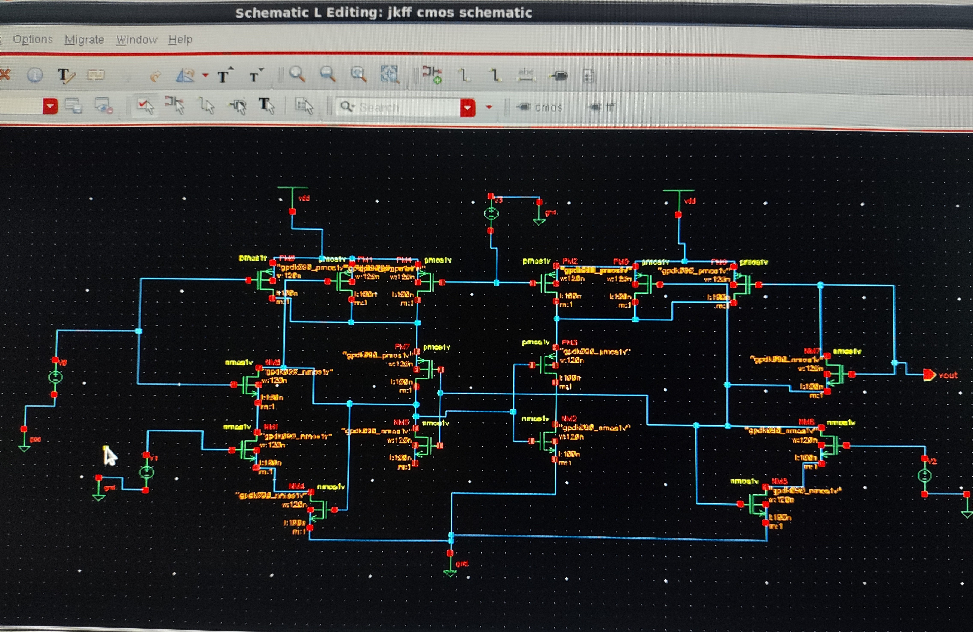
Schematic Diagrams
FLIPFLOPS(MEMORY)
SR-FlipFlop
JK-FlipFlop

Slide 10
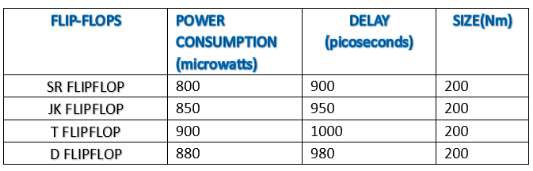
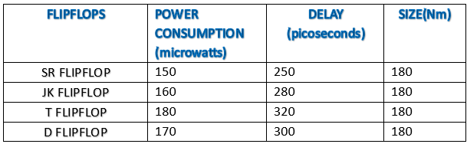

Parameters
BJT
Basic MOSFET
CMOS

Slide 11
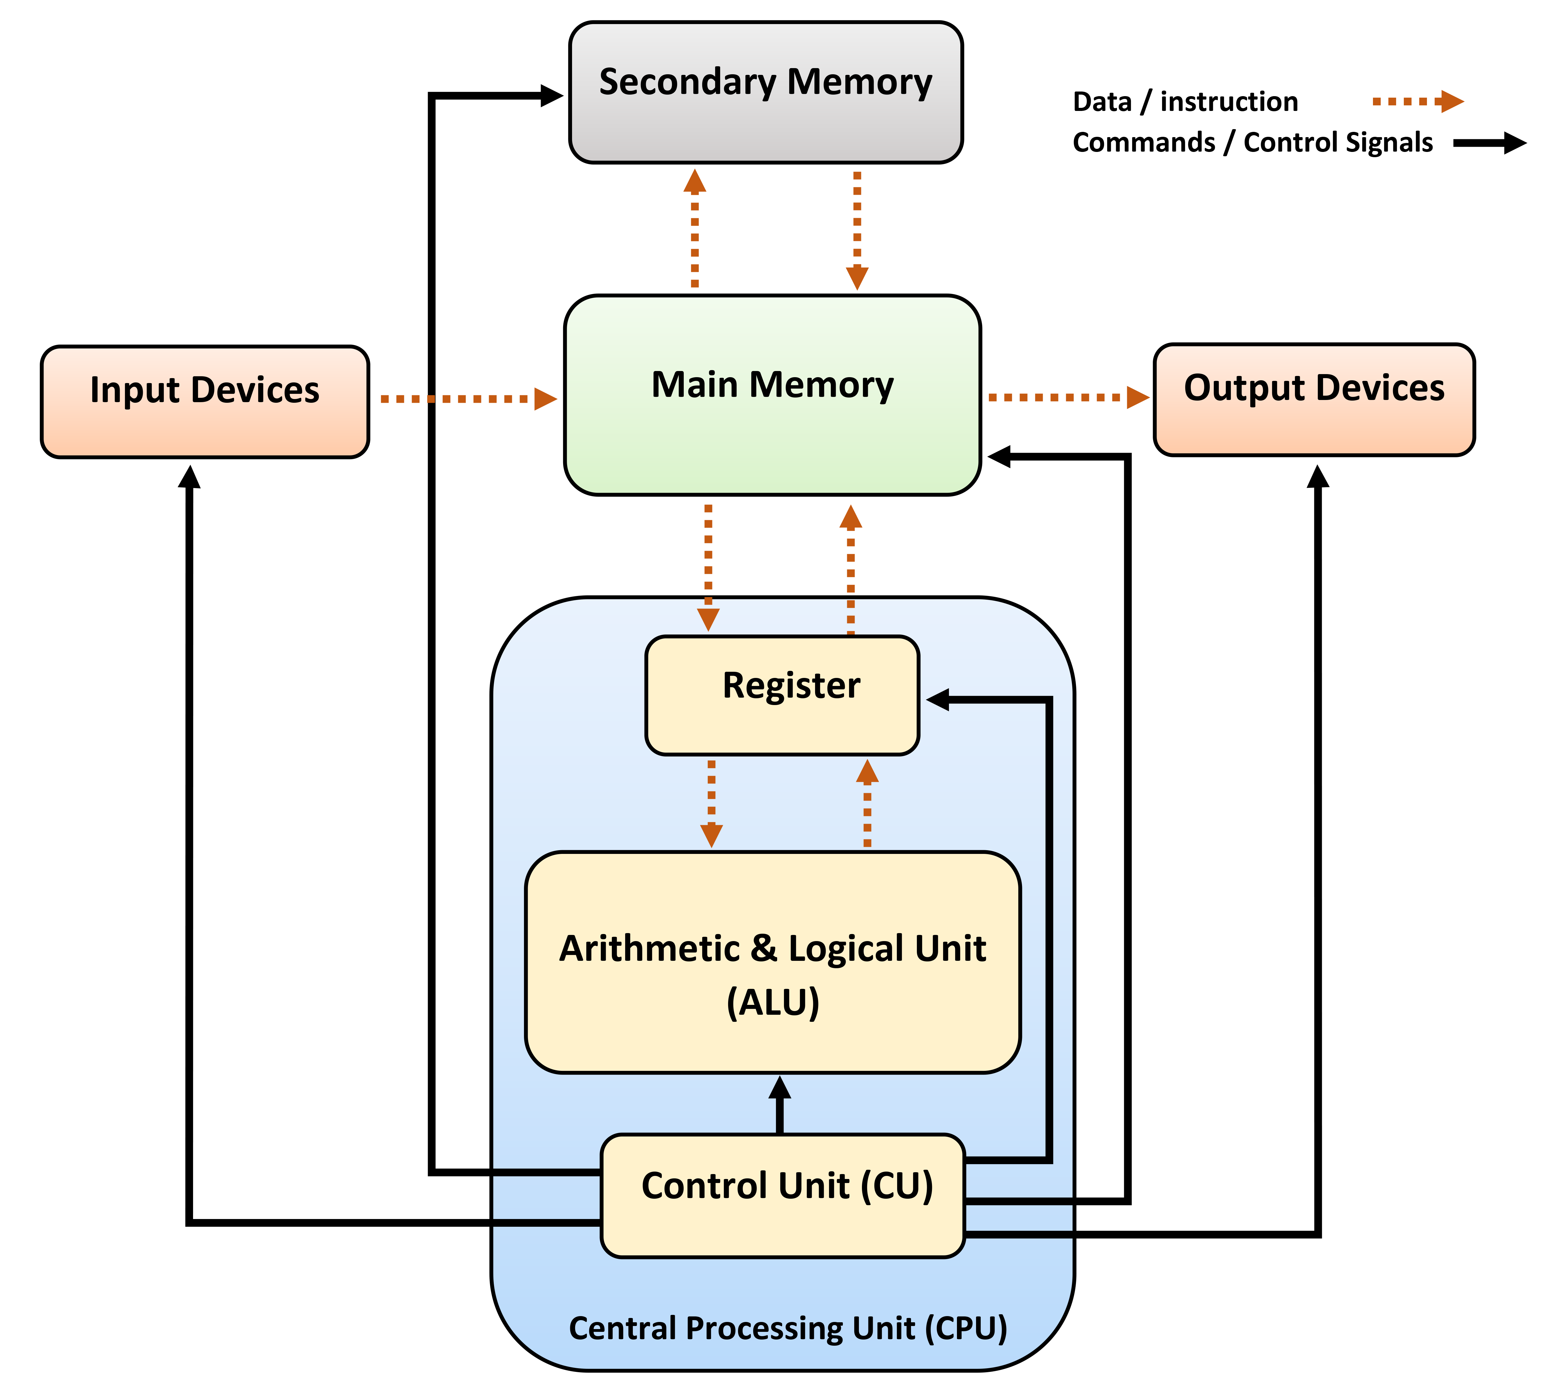
CPU[RISC Microprocessor]
low power consumption
fast execution
simpler design
cost-effective
pipelining

Slide 12
Implementation[CODE]
module risc1(
input clk, // Clock input
input rst, // Reset input
input [7:0] instruction, // 8-bit instruction input
output [7:0] result // 8-bit result output
);
// Internal signals
wire [7:0] reg1_data, reg2_data; // Data from registers
reg [7:0] alu_out; // ALU output (must be reg type)
wire zero_flag; // Zero flag from ALU
wire write_enable; // Enable writing to register file
wire [2:0] opcode; // ALU operation code
wire [2:0] reg1, reg2, reg_dest; // Register addresses
// Register File (8 registers, each 8 bits wide)
reg [7:0] registers [7:0]; // 8 registers, each 8 bits wide
// ALU Logic (Arithmetic Logic Unit)
always @(*) begin
case (opcode)
3'b000: alu_out = reg1_data + reg2_data; // ADD
3'b001: alu_out = reg1_data - reg2_data; // SUB
3'b010: alu_out = reg1_data & reg2_data; // AND
3'b011: alu_out = reg1_data | reg2_data; // OR
3'b100: alu_out = reg1_data; // MOV
default: alu_out = 8'b00000000; // Default to zero
endcase
end
// Zero Flag Logic (zero flag is 1 when ALU result is zero)
assign zero_flag = (alu_out == 8'b00000000) ? 1 : 0;
// Register File Read Logic (Read data from the registers)
assign reg1_data = registers[reg1]; // Read data from register 1
assign reg2_data = registers[reg2]; // Read data from register 2

Slide 13
Implementation[CODE]
// Instruction Decoding (Extract opcode and register addresses from the instruction)
assign opcode = instruction[7:5]; // Opcode is the upper 3 bits
assign reg1 = instruction[4:2]; // Register 1 is bits 4 to 2
assign reg2 = instruction[1:0]; // Register 2 is bits 1 to 0
assign reg_dest = instruction[4:2]; // Destination register (same as reg1 for now)
assign write_enable = 1'b1; // Always enable write (simplified control)
// Register File Write Logic (Write ALU output to the destination register)
always @(posedge clk or posedge rst) begin
if (rst) begin
// Reset all registers to 0 on reset signal
registers[0] <= 8'd0;
registers[1] <= 8'd0;
registers[2] <= 8'd0;
registers[3] <= 8'd0;
registers[4] <= 8'd0;
registers[5] <= 8'd0;
registers[6] <= 8'd0;
registers[7] <= 8'd0;
end else if (write_enable) begin
// Write ALU output to the destination register
registers[reg_dest] <= alu_out;
end
end
// Final result output (assign ALU output to result)
assign result = alu_out;
endmodule

Slide 14
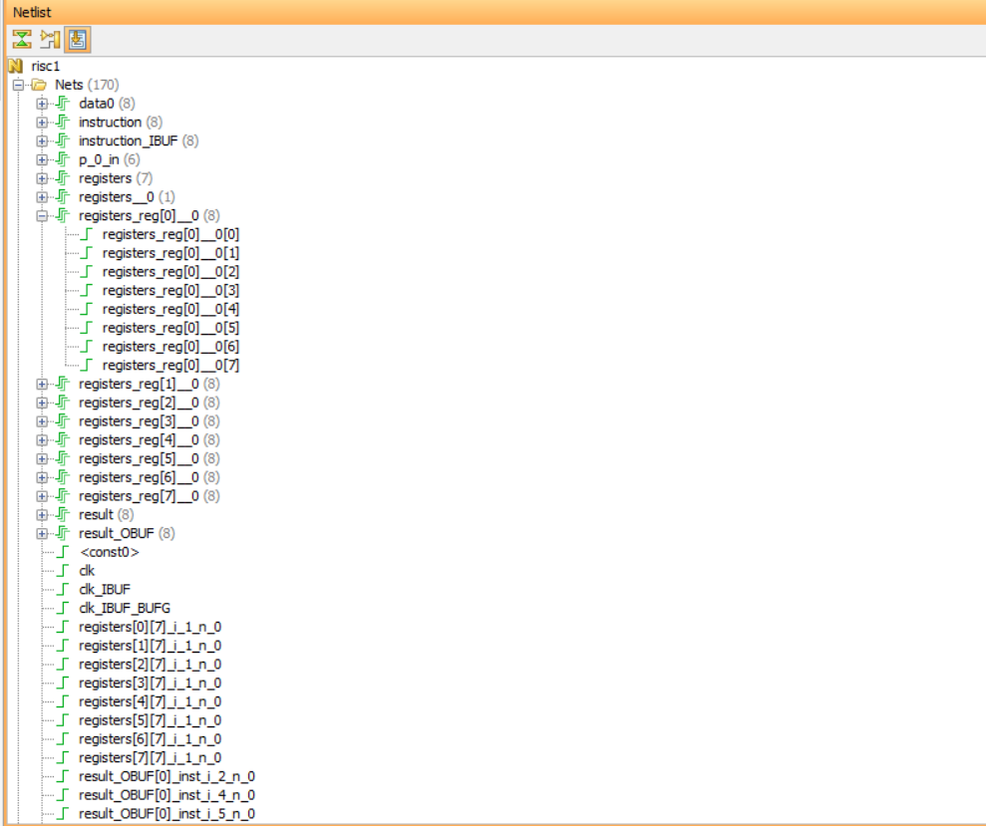
NETLIST

Slide 15
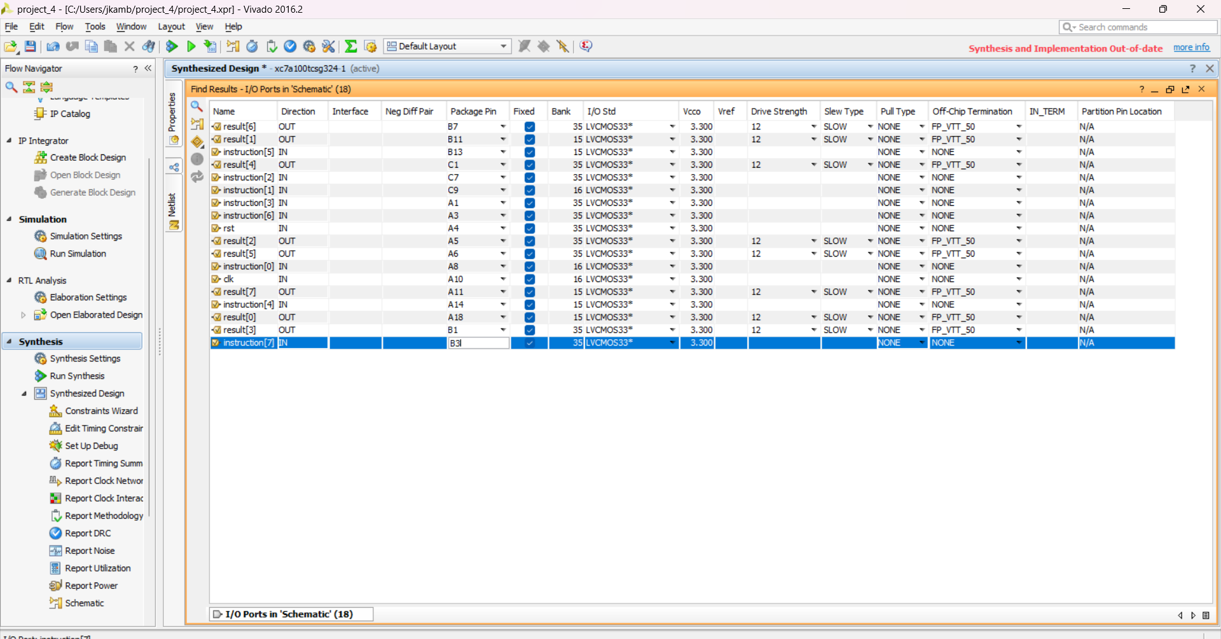
Synthesized design

Slide 16
Contribution
Team Progress and Movement
ALU
memory
RISC processor[CPU]
Individual Contribution
Key contributions: Voruguntla Mounika
Implementation of circuits using CMOS technology and checking the parameters power consumption, area, size and delay.
Documentation work ( ppt , word document) .
Implemented a RISC processor .
Key contributions: Polimera Sandeep Reddy
Implementation of circuits using basic MOSFET technology and checking the parameters power consumption, area, size and delay.
Updating project in Github.
Key contributions: Yeruva Aditya udaya Reddy
Literature survey.
Collecting required information.
Works on ADC and DAC.

Slide 17
Conclusion & Future Work
Summary and Conclusion
RISC Processor in Verilog (Xilinx Vivado): This method uses coding (Verilog) to design a processor, which can be tested and run on an FPGA. It is faster and easier since you work with digital logic instead of individual transistors.
Building with Transistors (Cadence CMOS/BJT/MOSFET):This approach designs the processor at the transistor level, using CMOS, BJT, MOSFET. It gives more control over power and performance but is much harder and takes more time.
Our project aims to design a microprocessor by studying and integrating analog, digital, and mixed-signal systems using advanced semiconductor technologies such as BJT, CMOS, and MOSFET.
The focus is on leveraging the unique characteristics and strengths of each technology to optimize the performance, power consumption, area, and delay of the microprocessor.
Future Work
This future work plan outlines the key steps and considerations involved in designing a microprocessor using ALU, flip-flops, ADC, DAC, filters, and op-amps using FINFET technology
By following this plan, we aim to develop a high-performance and reliable microprocessor that meets the specific requirements of our project.

Slide 18
THANK YOU
Have a Great Day !

